Slide 1
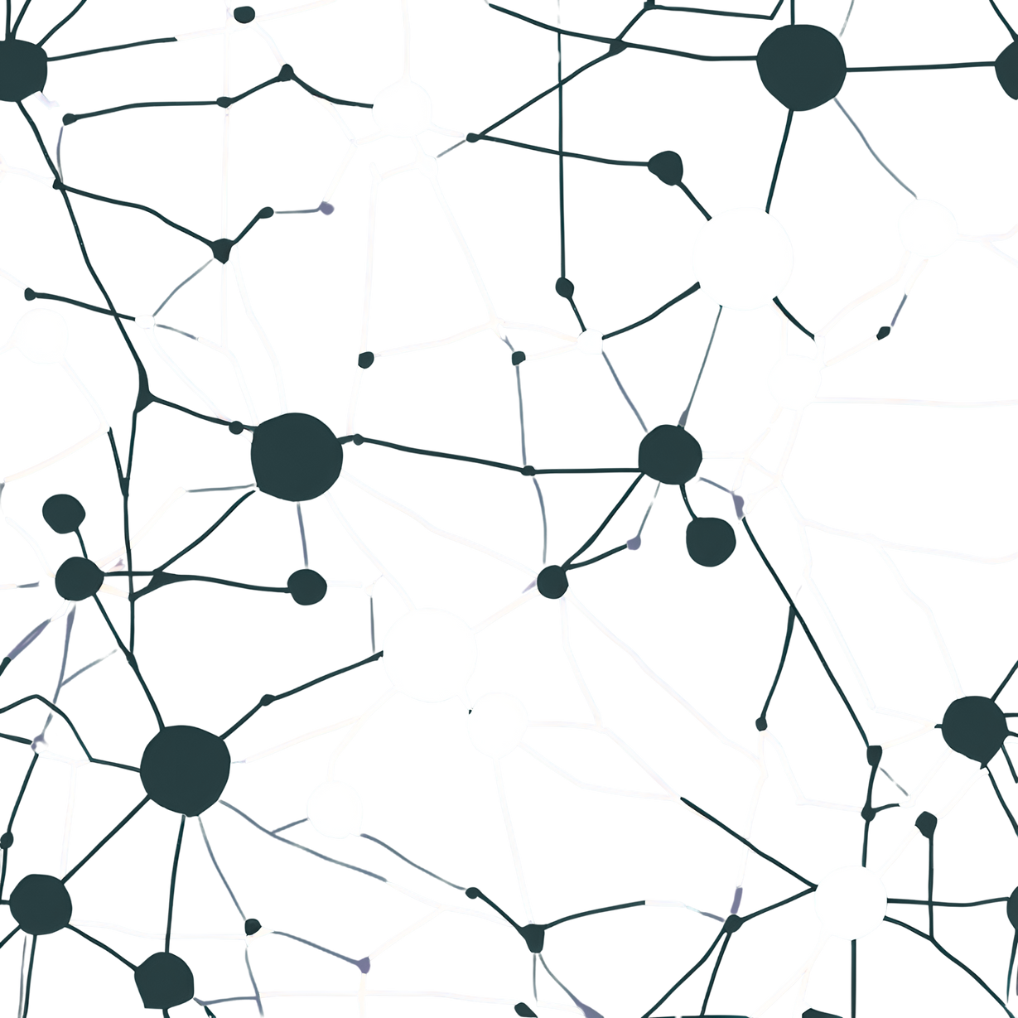
Introduction to Machine Learning
University of Essex
CNN for
Object Recognition
CIFAR-10

Slide 2

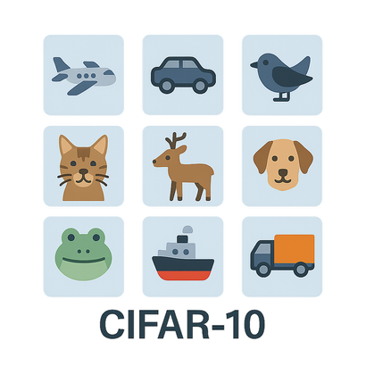

Introduction to Machine Learning
University of Essex
Introduction
Importance of Object Recognition
Fundamental advance in Computer Vision (Deep Learning)
Real-world AI applications:
Autonomous vehicles (real-time detection of vehicles, pedestrians, road signs)
Facial recognition systems (security, device unlocking)
Surveillance systems (automatic detection of suspicious activity)
Why CIFAR-10?
Benchmark dataset for evaluating and improving models
Insights applicable to real-world scenarios
Presentation Goals
Explore CNN capabilities in image recognition
Evaluate design choices for high accuracy
Share results, insights, and practical lessons learned

Slide 3
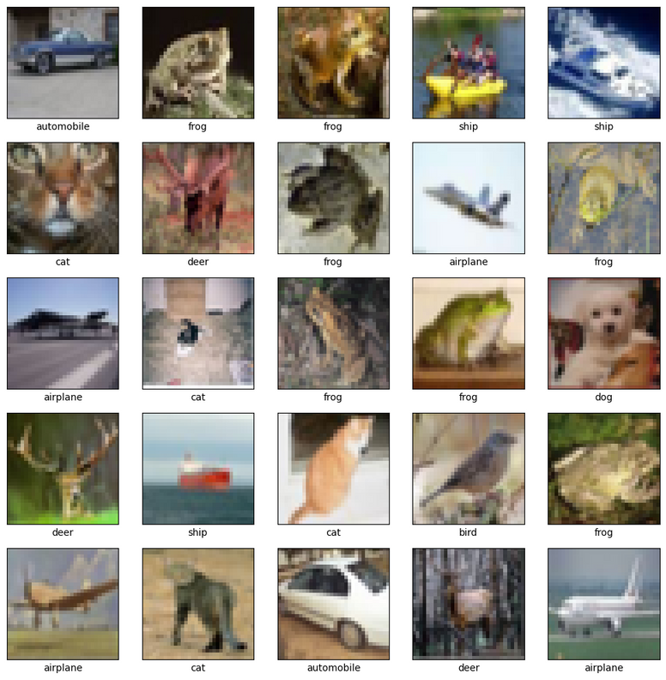
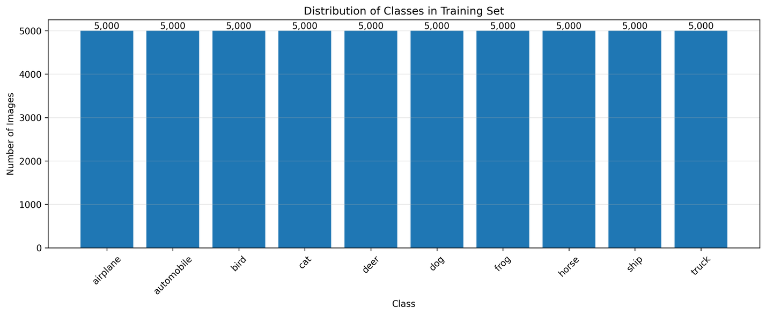
Introduction to Machine Learning
University of Essex
Dataset
CIFAR-10 Overview:
Widely used benchmark in Image Classification
60,000 color images (32×32 pixels)
10 classes
Airplane, Automobile, Bird, Cat, Deer, Dog, Frog, Horse, Ship, Truck
Balanced: 6,000 images/class
Train/Test split: 50,000/10,000
Very low-resolution and visually ambiguous

Slide 4
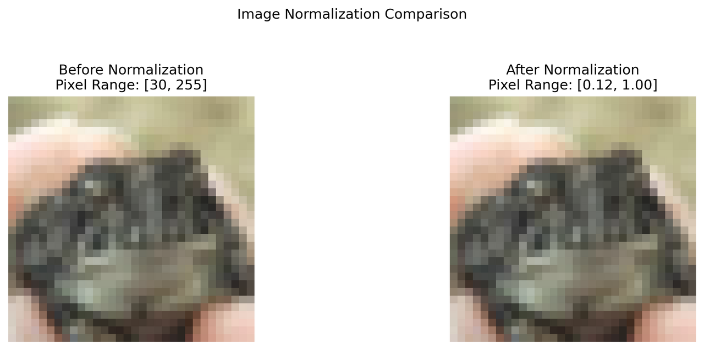
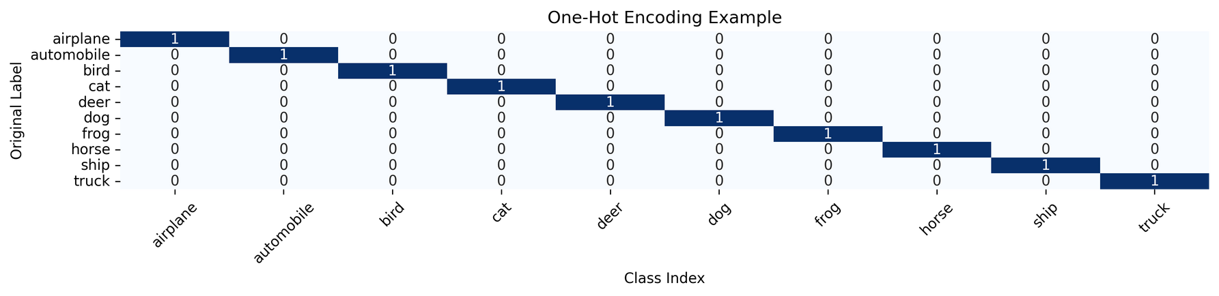
Introduction to Machine Learning
University of Essex
Preprocessing Workflow
Normalization:
Pixel Values from [0, 255] → [0, 1]
Faster and stable model convergence
One-Hot Encoding:
Labels 0–9 → e.g. “2” becomes [0, 0, 1, 0, 0, 0, 0, 0, 0, 0]
Needed for multi-class classification

Slide 5
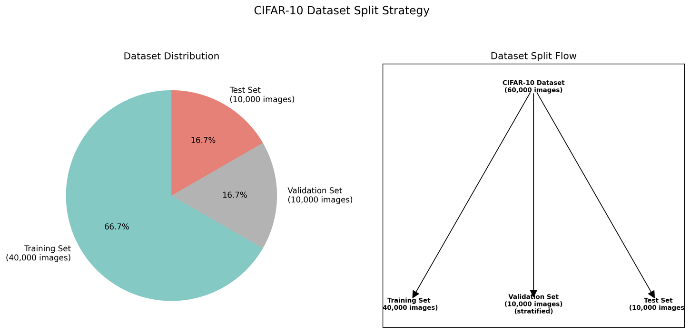
Introduction to Machine Learning
University of Essex
Data Partitioning Strategy
This separation gives an unbiased performance estimate during training and ensures fair model evaluation.(Goodfellow et al, 2016)
Validation metrics help us choose the best model
Needed for validation accuracy/loss to optimize model architecture (e.g., number of layers, units, dropout, etc.).

Slide 6
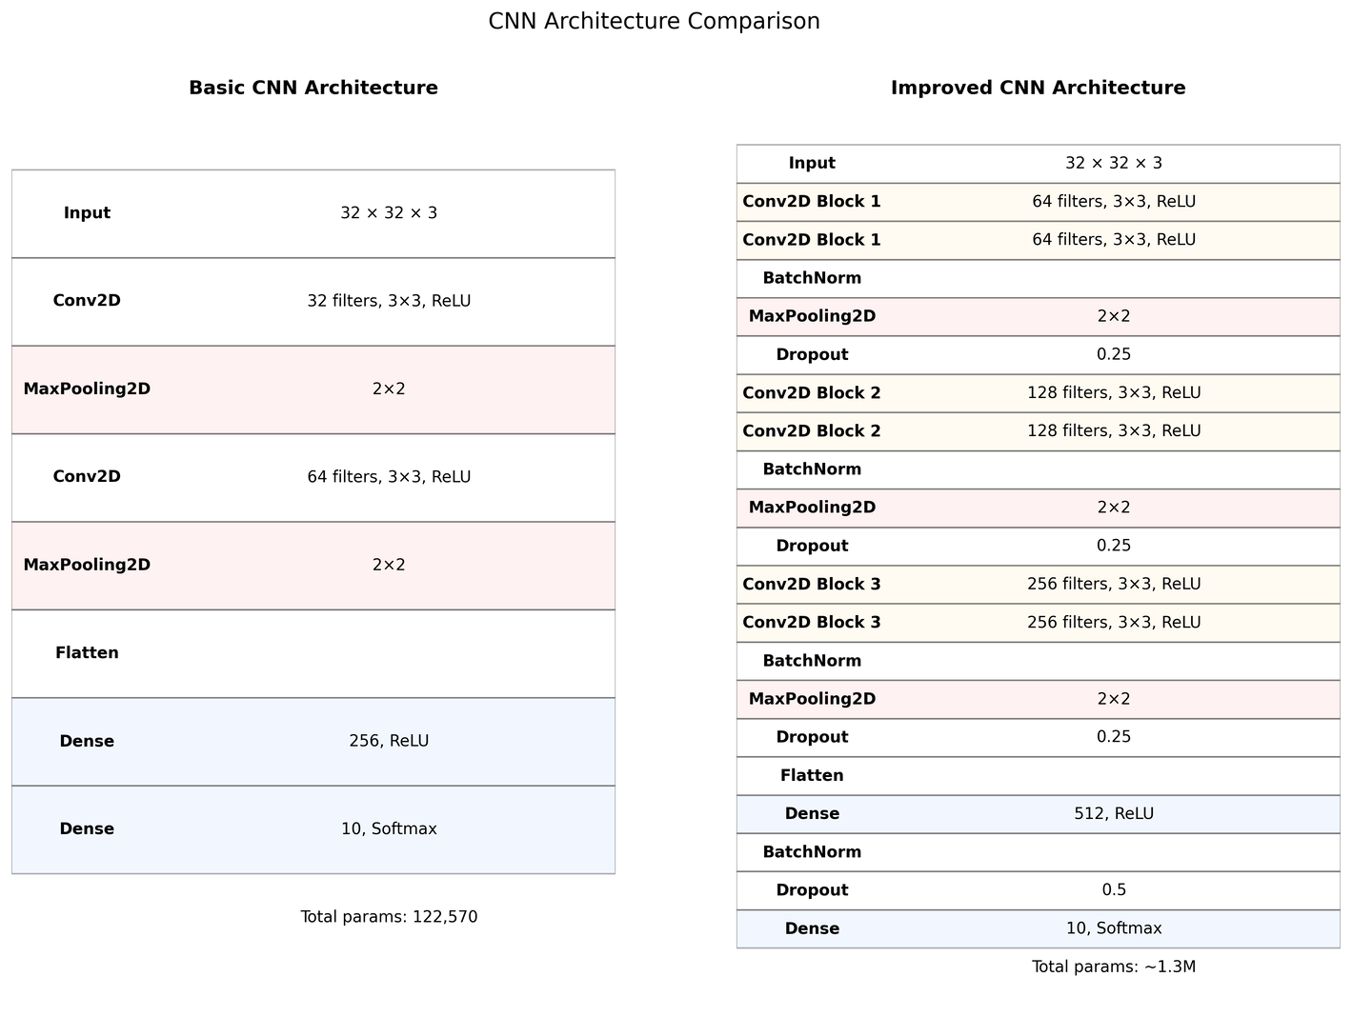
Introduction to Machine Learning
University of Essex
CNN Architecture - Baseline vs Improved
Baseline Model
Inspired by LeNet-5 & Chollet (2018) patterns
Goal: establish a basic performance benchmark
Limitations: Risk of Underfitting - Learns low-level features only (edge, textures)
Improved Model
BatchNorm: stabilizes training + mild regularization\
Dropout: combats overfitting by reducing co-adaptation
L2: penalizes overly large weights
Reflects best practices from Xia (2023) on CIFAR-10

Slide 7
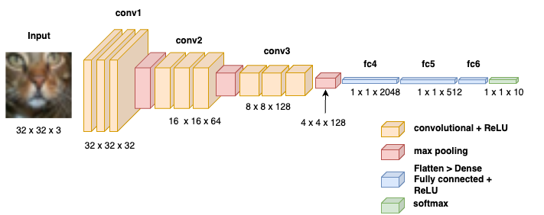
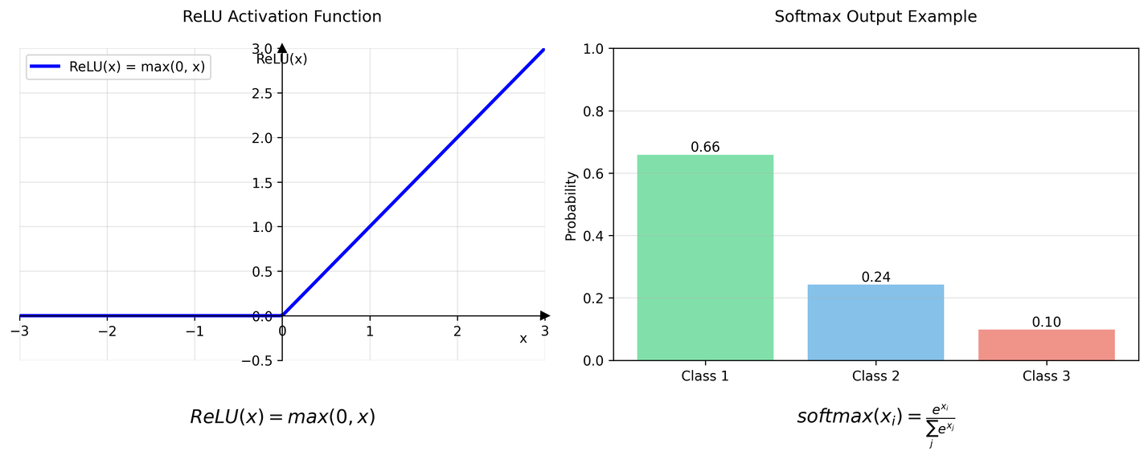
Introduction to Machine Learning
University of Essex
CNN Architecture - Activation & Loss Functions
Activations
ReLU for Conv + Dense layers
Computational efficient & avoids vanishing gradients
Enables succesfull training in deeper networks (Goodfellow et al., 2016)
Softmax for Output
Transforms raw logits into class probabilities
Ensure outputs are positive
Loss Function
Categorical cross-entropy
Measures the difference between predicted and true probability distribution.
Loss is lowest when the model is confident & correct
Recommended by Chollet (2018), Goodfellow (2016)

Slide 8
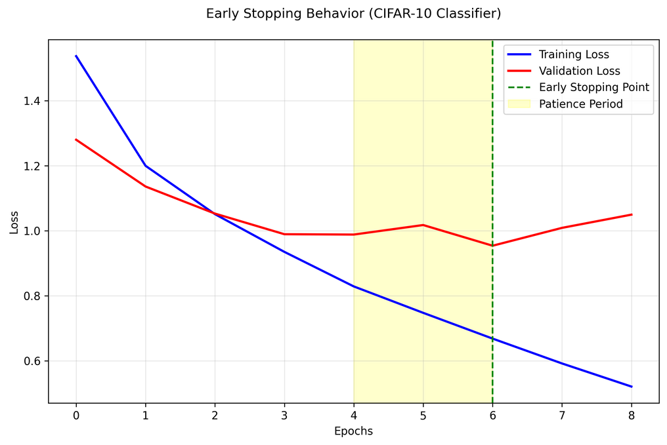
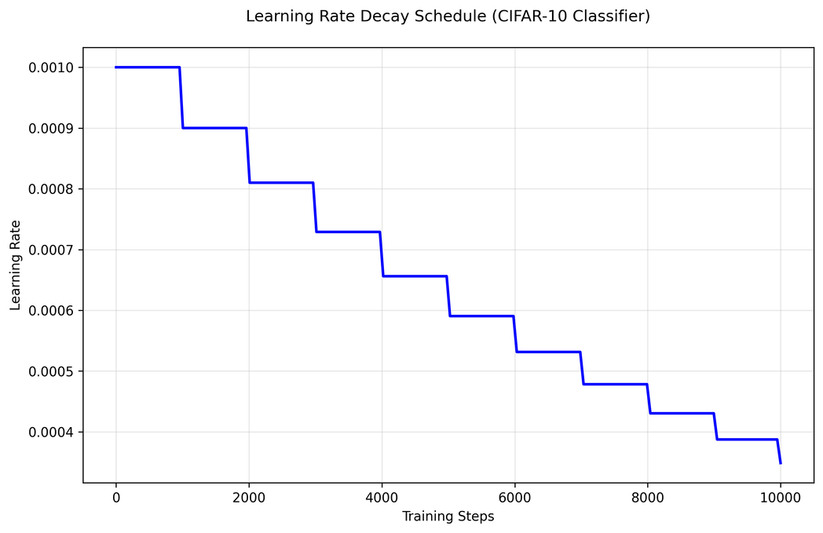
Introduction to Machine Learning
University of Essex
Training Hyperparamenters
Epochs
Baseline: max 25 epochs (usually stops at ~10)
Improved model: max 50 epochs
Early Stopping: stops training if val loss doesn’t improve for 3 epochs
Prevents overfitting
Recommended by Goodfellow et al., 2016
Batch Size = 64
Efficient GPU computation
Stochasticity → helps generalization
Based on:
Literature (e.g. Chollet, 2018)
Keras examples on CIFAR-10
Optimizer – Adam
Combines momentum + RMSprop ideas
Adaptive learning per parameter
Initial LR = 0.001 (default)
Fast convergence, minimal tuning
Learning Rate Scheduling
Used Exponential Decay for improved model
Every few steps: LR × 0.9
Result: smoother val loss curve, avoids overshooting

Slide 9
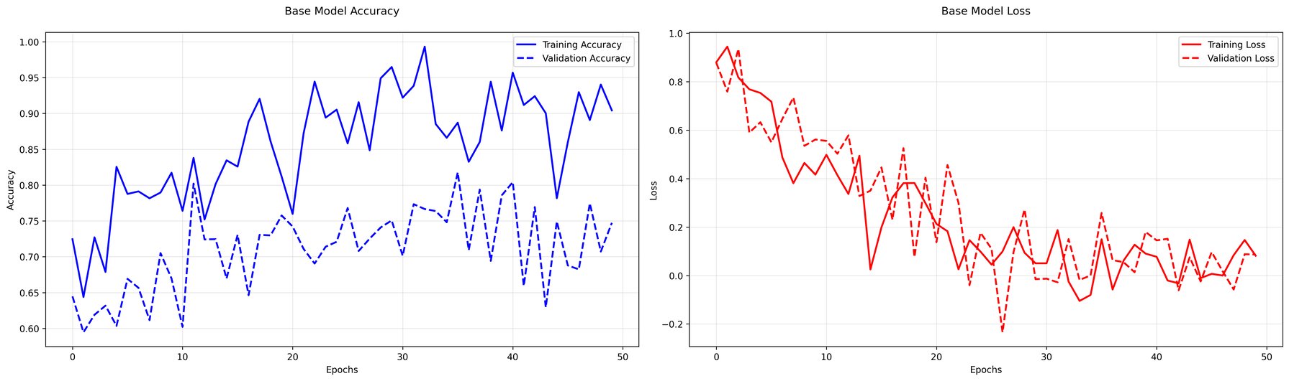
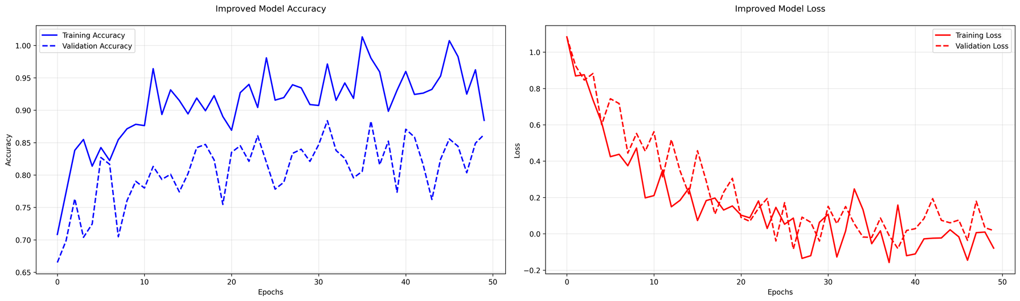
Introduction to Machine Learning
University of Essex
Model Evaluation & Performance
Learning Curves: Training vs Validation
Baseline model:
Training accuracy ↑
Validation accuracy ↓ after epoch ~6
Validation loss ↑ while training loss ↓ → Overfitting
Accuracy : ~70%
Improved model:
Training & validation curves are aligned
Validation accuracy reaches ~85%
Smooth decrease in loss → Better generalization
Accuracy : ~85%
Key take-away: Regularization + deeper architecture = major performance boost

Slide 10
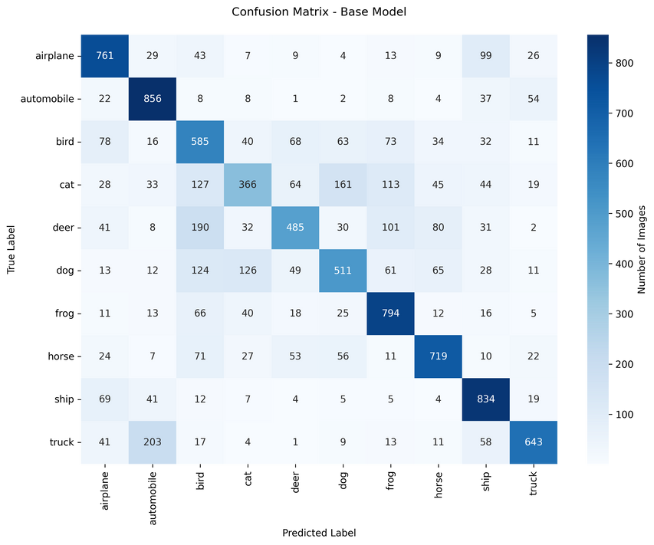
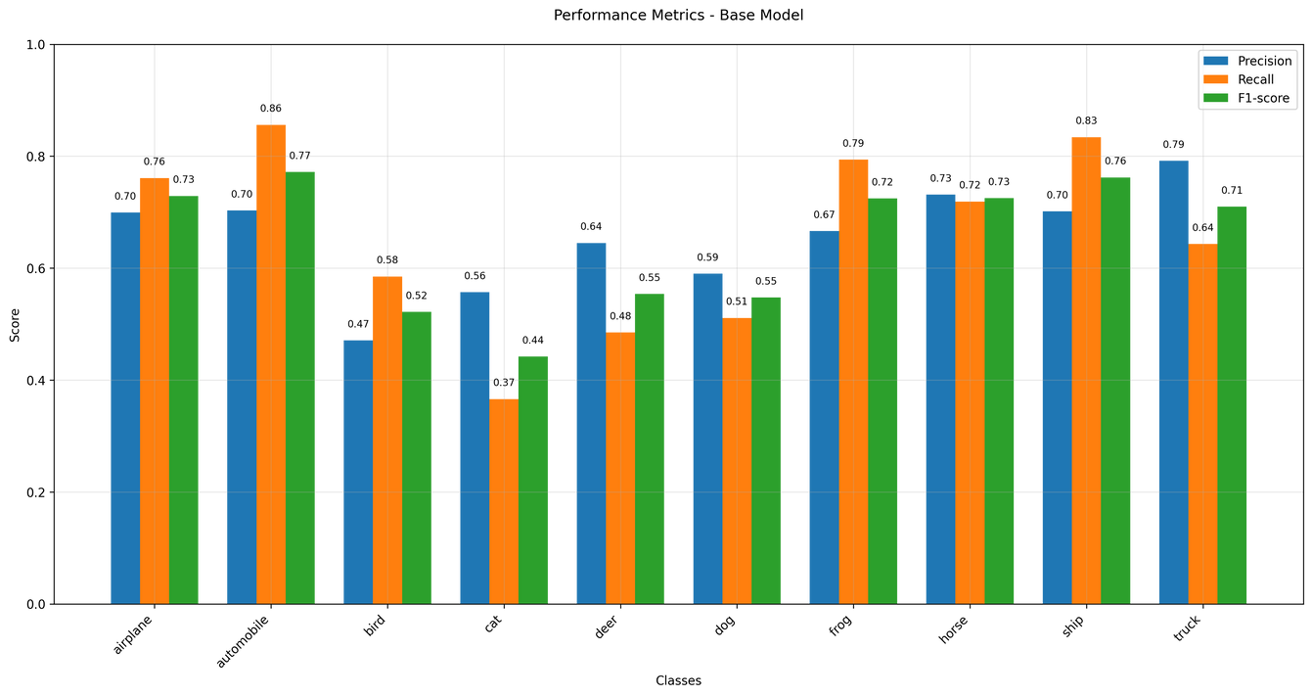
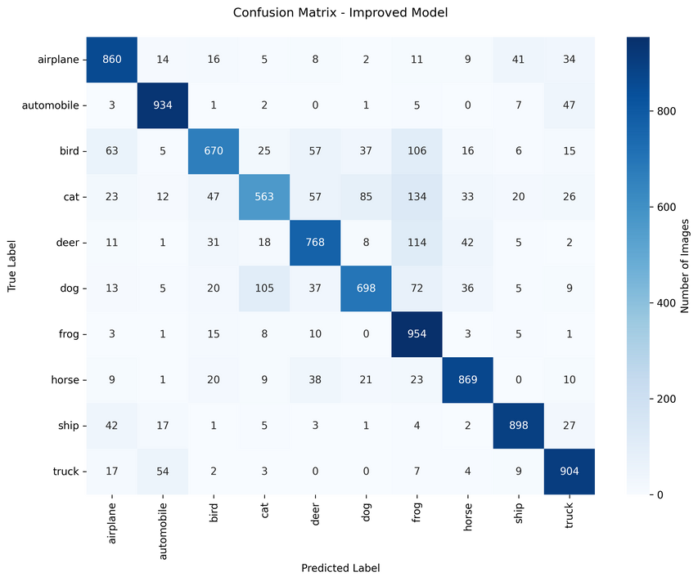
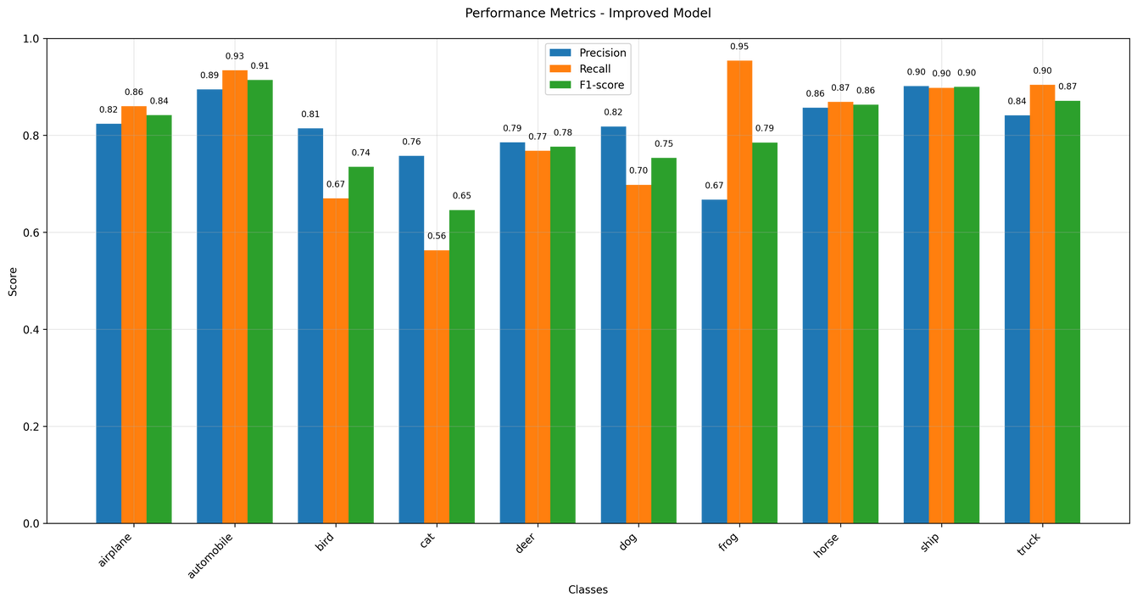
Introduction to Machine Learning
University of Essex
Model Evaluation & Performance
Confusion Matrix Insights
Strong performance in distinctive classes (e.g., ship, airplane)
Common confusions:
Cat vs Dog
Automobile vs Truck
Example:“Cat” correctly classified ~80%, misclassified as dog ~15%
Rarely confuses unrelated classes (e.g., frog vs ship)
Precision, Recall & F1-score
Ship class:
Precision: ~0.90 | Recall: ~0.85 → F1: ~0.87
Cat class:
Precision: ~0.80 | Recall: ~0.75 → F1: ~0.77
Automobile vs Truck
Macro average (all classes):
Precision: ~0.85
Recall: ~0.84
F1-score: ~0.85

Slide 11
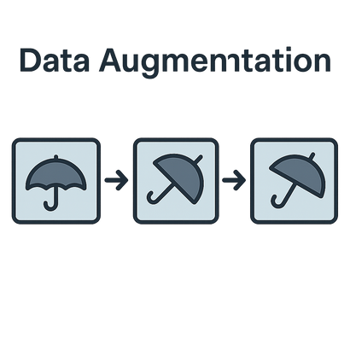
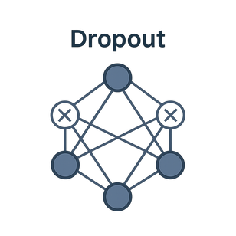
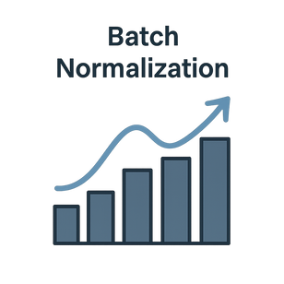
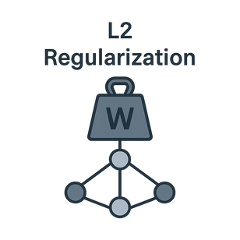
Introduction to Machine Learning
University of Essex
Regularization Techniques & Improvements
Data Augmentation
Random rotations (±15°), flips, shifts
Increases data variety without extra labels
Prevents memorization of training samples
Boosted validation accuracy + reduced overfitting
Shorten & Khoshgoftaar (2019)
Dropout 0.2 → 0.5
Randomly disables neurons during training
Reduces co-adaptation and forces redundancy
Narrowed gap between training/validation accuracy
Training accuracy ↓ (expected) → Validation accuracy ↑
Srivastava et al., 2014
Batch Normalization
Normalizes activations → stable layer input distribution
Enables faster training with higher learning rates
Smoother convergence + slight regularizing effect
Improved deeper layer stability and learnability
L2 Regularization (λ = 0.01)
Penalizes large weights → favors simpler models
Encourages generalization by smoothing learned functions
Slight reduction in training accuracy
Lower variance in validation performance
Xia (2023)
Results: Model deep enough to learn & regularized enough to generalize well on unseen data

Slide 12



Introduction to Machine Learning
University of Essex
Reflection: Learning Outcome & Future Work
Challenges
Finding the right architecture complexity
Hyperparameters tunning was tricky
Overfitting happened too early
Augmentation parameters needed care
Understanding evalutiation metrics
Lessons Learned
Learned the interconnectedness of architecture, hyperparameters, and regularization.
Discovered value in experimentation and analyzing failures.
Deepened understanding of CNN layers, feature extraction, and image classification
Real World Application & Future Work
CNNs like ours power object recognition in self-driving cars, smartphones, and security.
Techniques used (dropout, augmentation, L2) are industry-standard in production models. (Srivastava et al., 2014; Howard et al., 2017; Goodfellow et al., 2016).
Builds foundation for advanced models (e.g., MobileNet in Google Lens, ResNet in Tesla Autopilot)

Slide 13
Introduction to Machine Learning
University of Essex
References
Goodfellow, I., Bengio, Y. & Courville, A. (2016) Deep Learning. Cambridge: MIT Press.
Chollet, F. (2018) Deep Learning with Python. Shelter Island: Manning Publications.
Srivastava, N., Hinton, G., Krizhevsky, A., Sutskever, I. & Salakhutdinov, R. (2014) Dropout: a simple way to prevent neural networks from overfitting. Journal of Machine Learning Research 15(1): 1929-1958.
Xia, Z. (2024) Overfitting of CNN model in CIFAR-10: Problem and solutions. Applied and Computational Engineering 37(1): 212-221.
Shorten, C. & Khoshgoftaar, T. M. (2019) A survey on image data augmentation for deep learning. Journal of Big Data 6(1): 1-48.
Labelf.ai (2022) What is Accuracy, Precision, Recall and F1 Score? Available from: https://www.labelf.ai/blog/what-is-accuracy-precision-recall-and-f1-score [Accessed 13 April 2025].
KDnuggets (2018) The Keras 4 Step Workflow. Available from: https://www.kdnuggets.com/2018/06/keras-4-step-workflow.html [Accessed 13 April 2025].
Krizhevsky, A. & Hinton, G. (2009) CIFAR-10 Dataset. University of Toronto. Available from: https://www.cs.toronto.edu/~kriz/cifar.html [Accessed 13 April 2025].
Howard, A.G., Zhu, M., Chen, B., Kalenichenko, D., Wang, W., Weyand, T., Andreetto, M. and Adam, H., 2017. MobileNets: Efficient Convolutional Neural Networks for Mobile Vision Applications. arXiv preprint arXiv:1704.04861

Slide 14
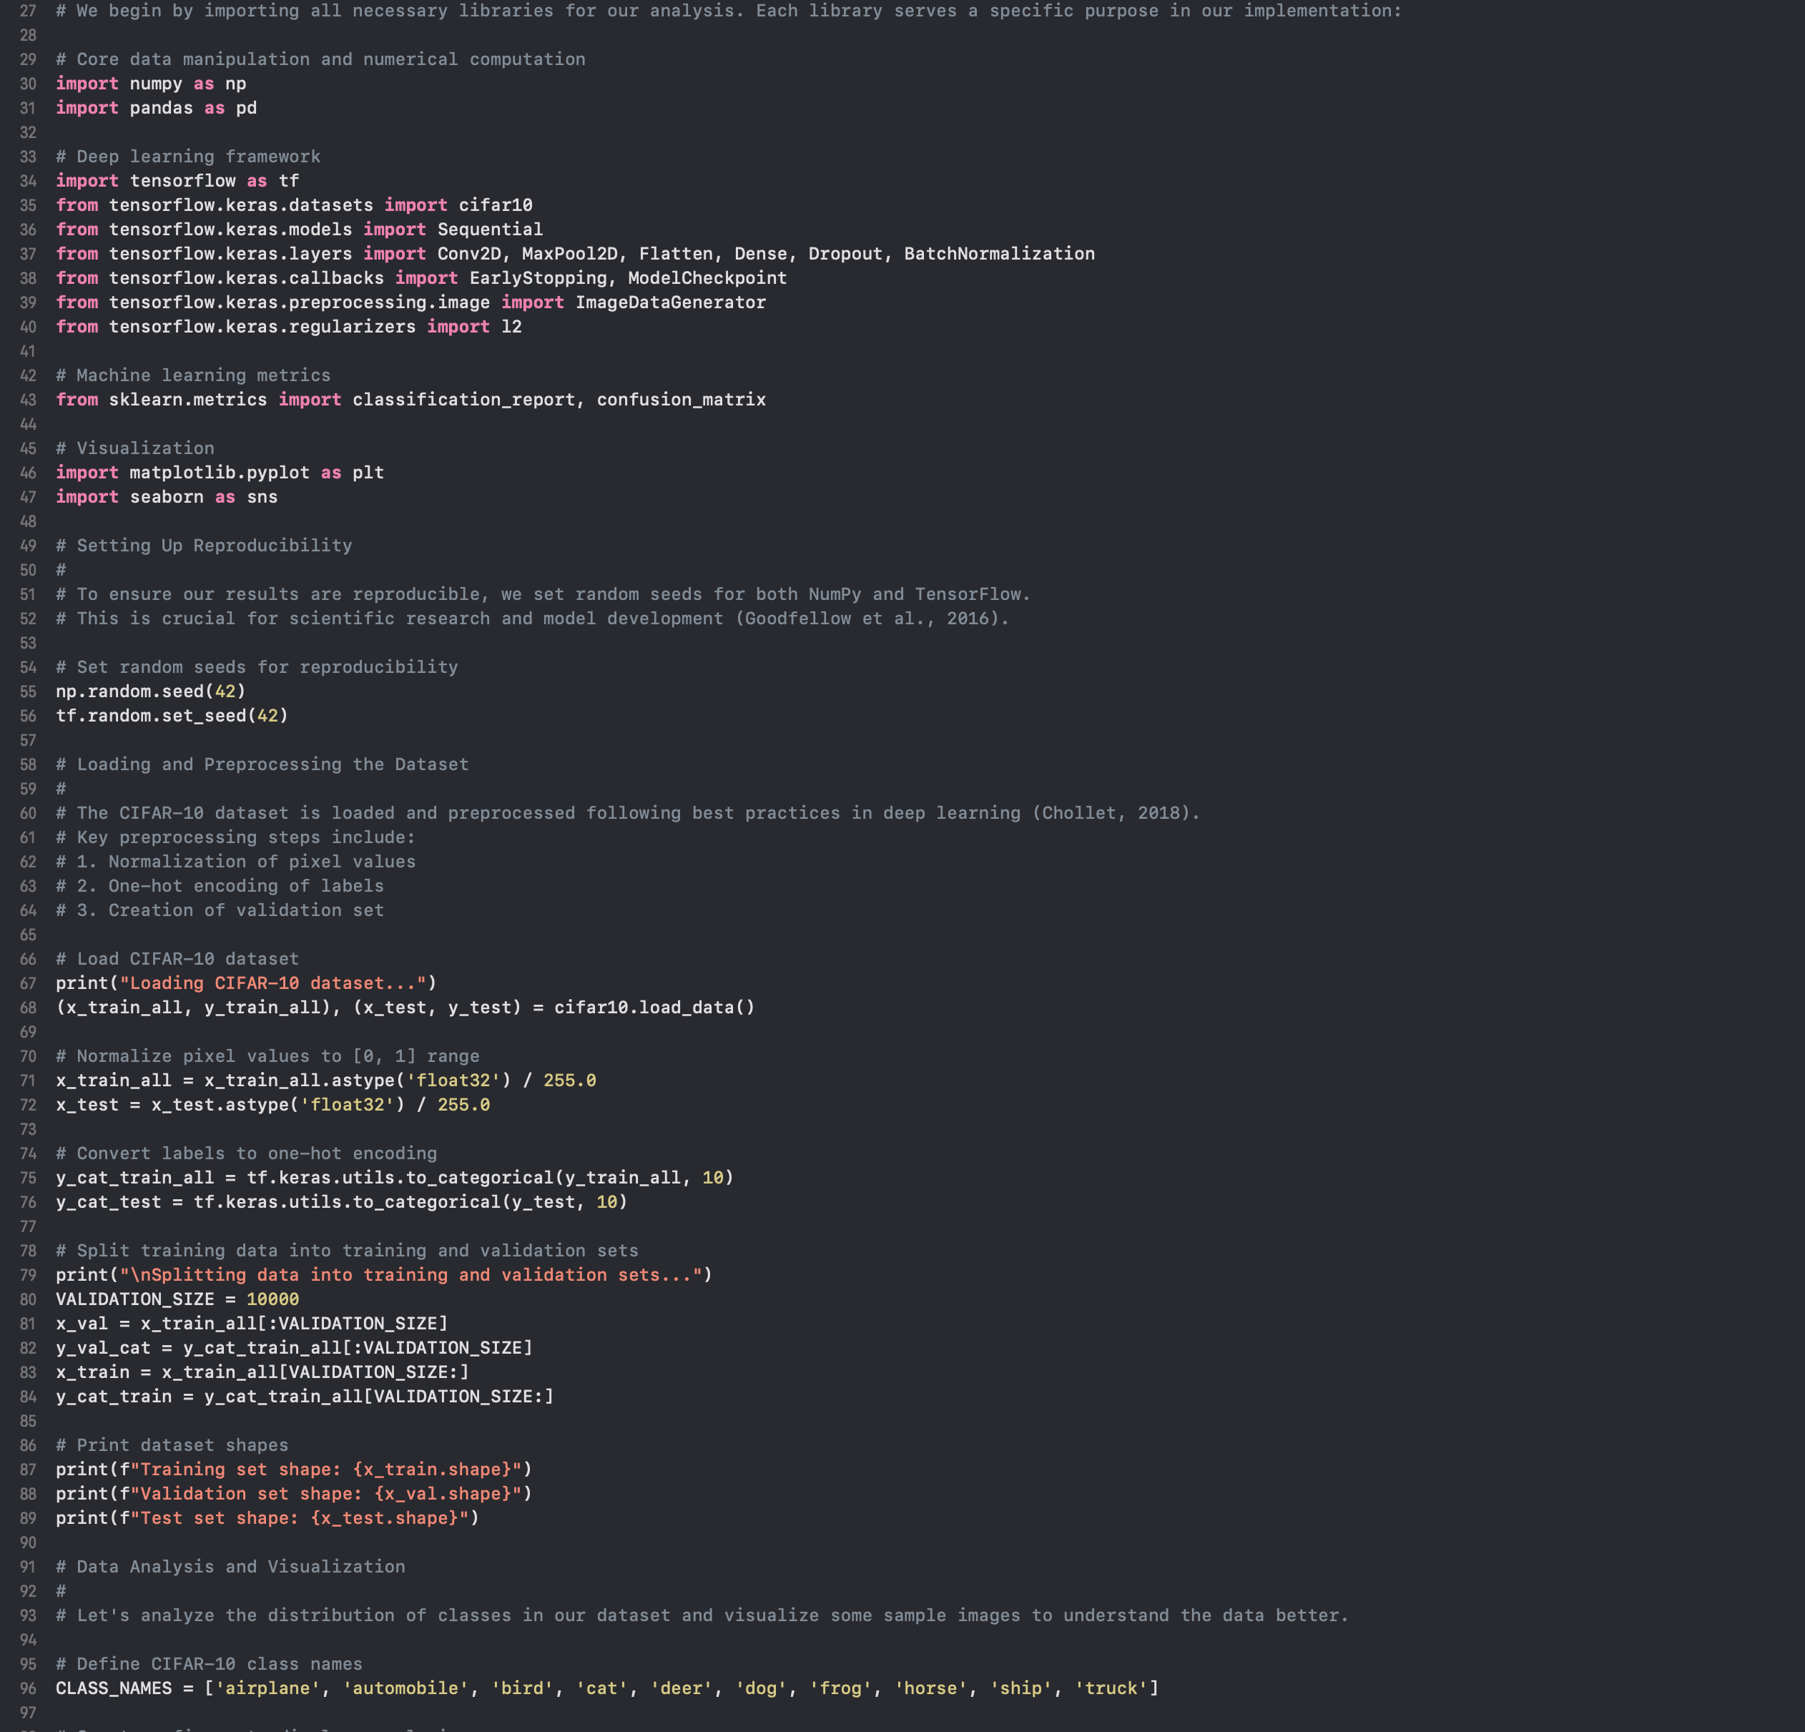
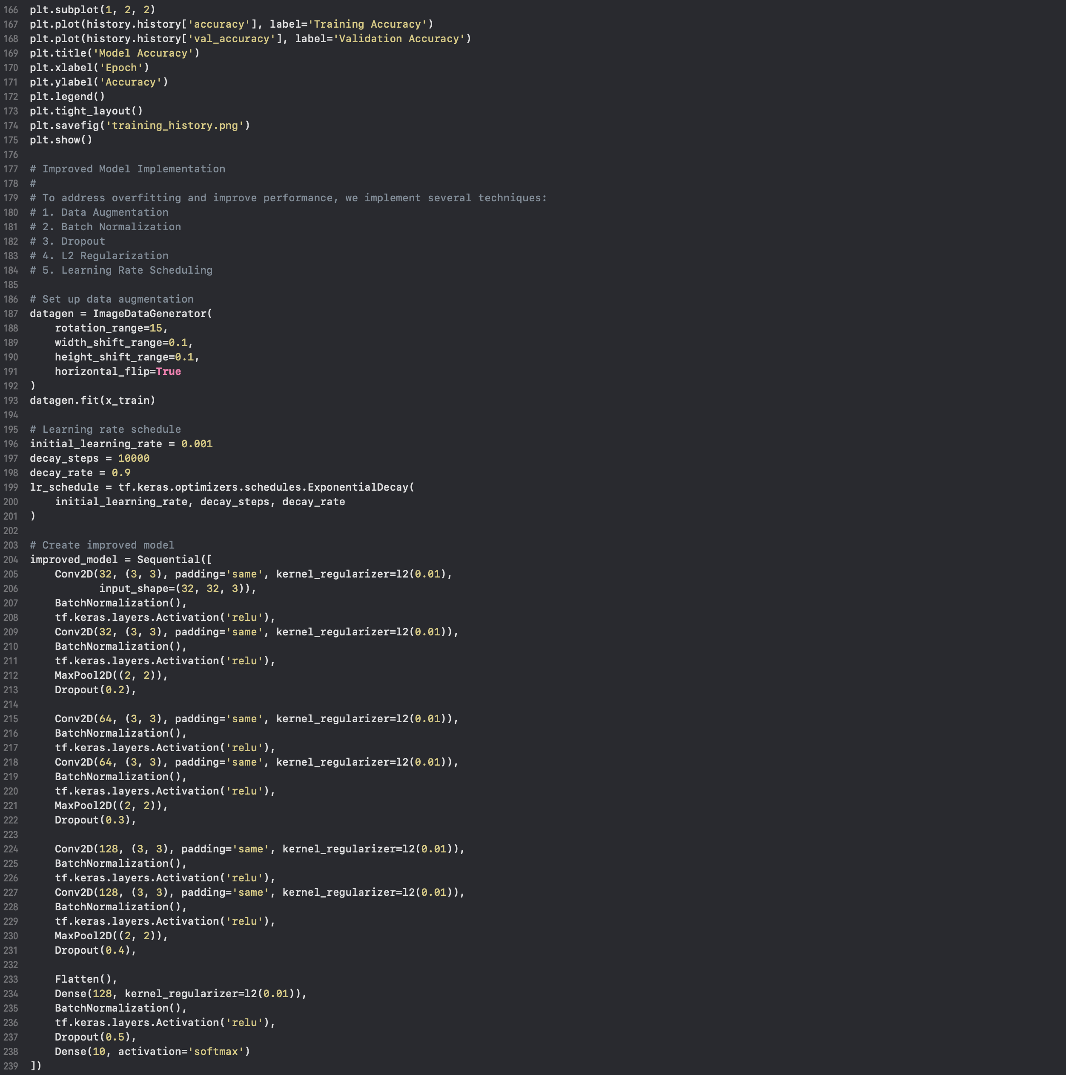
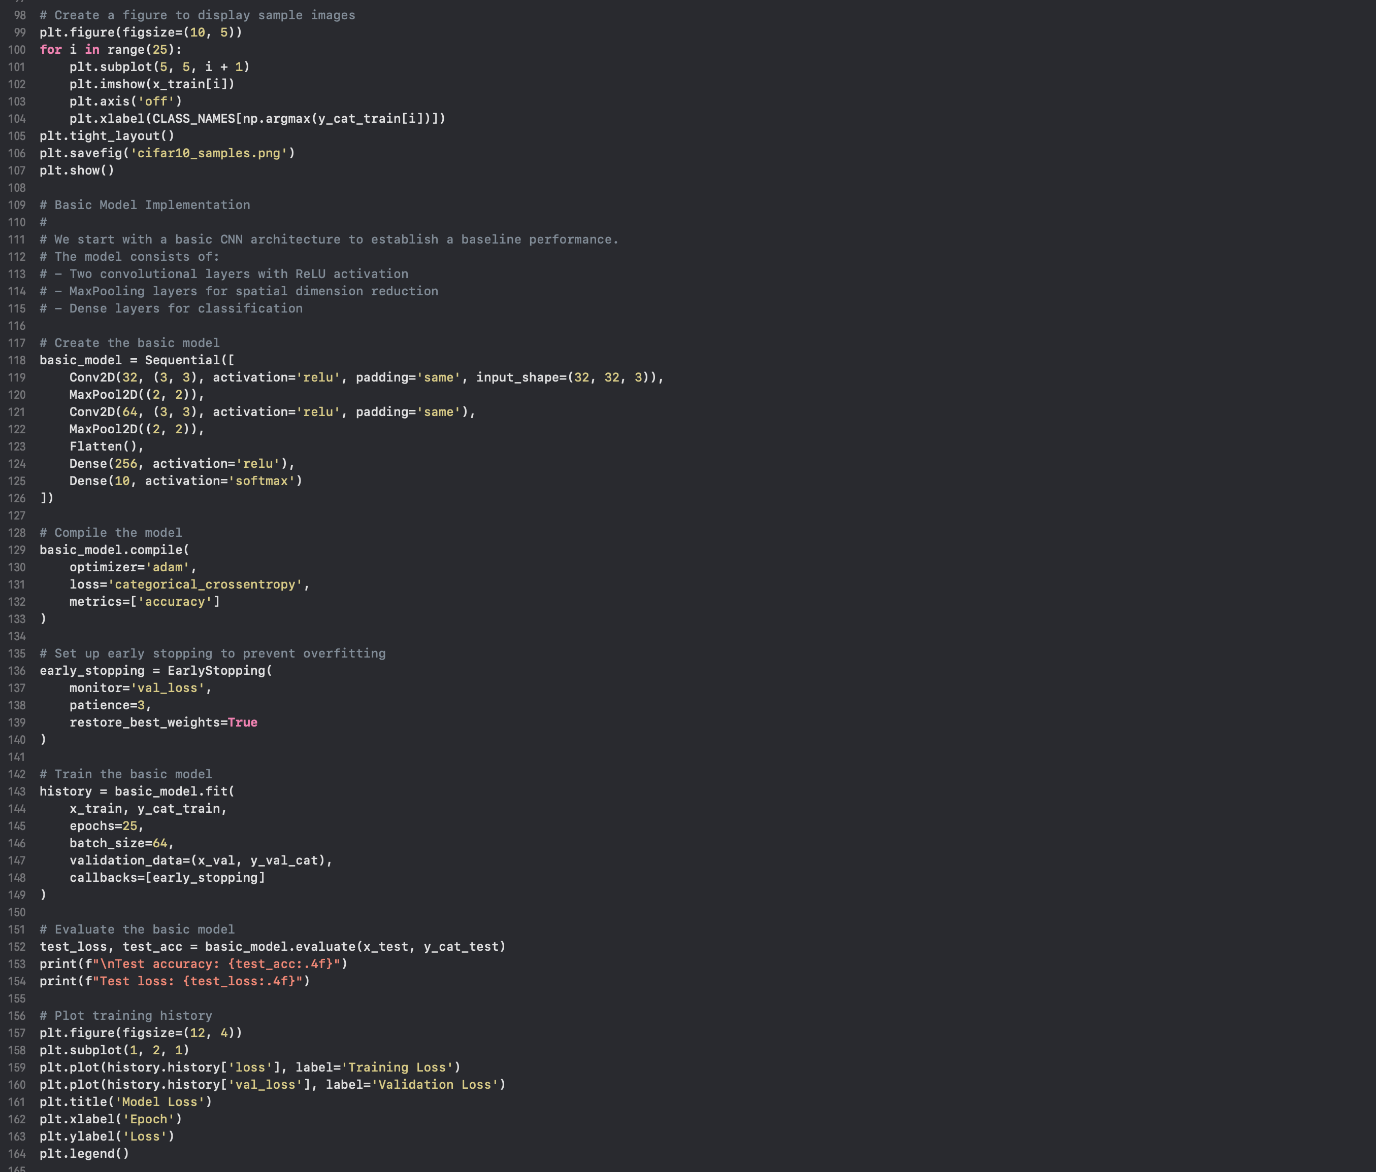
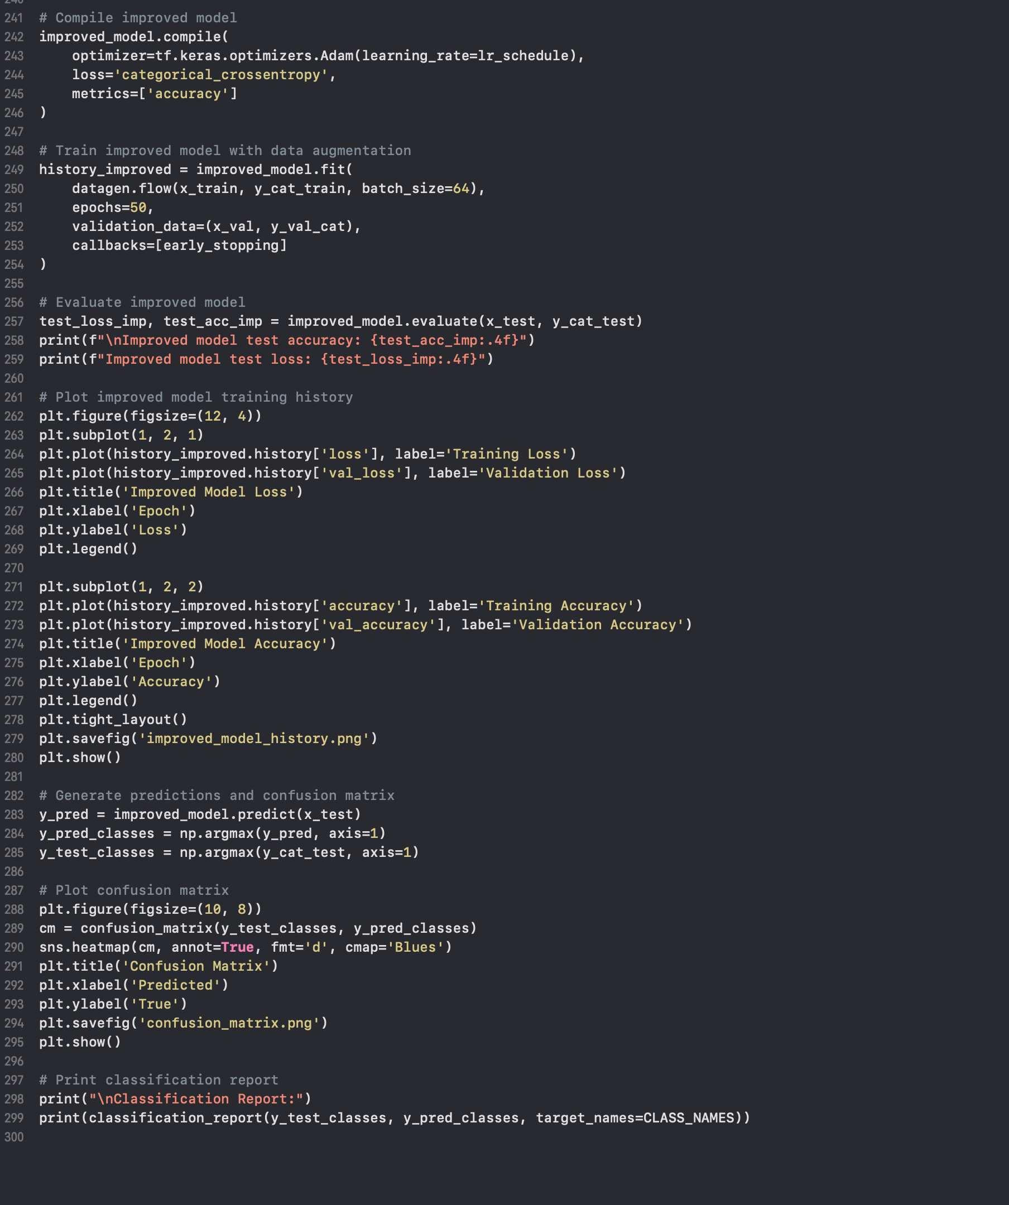
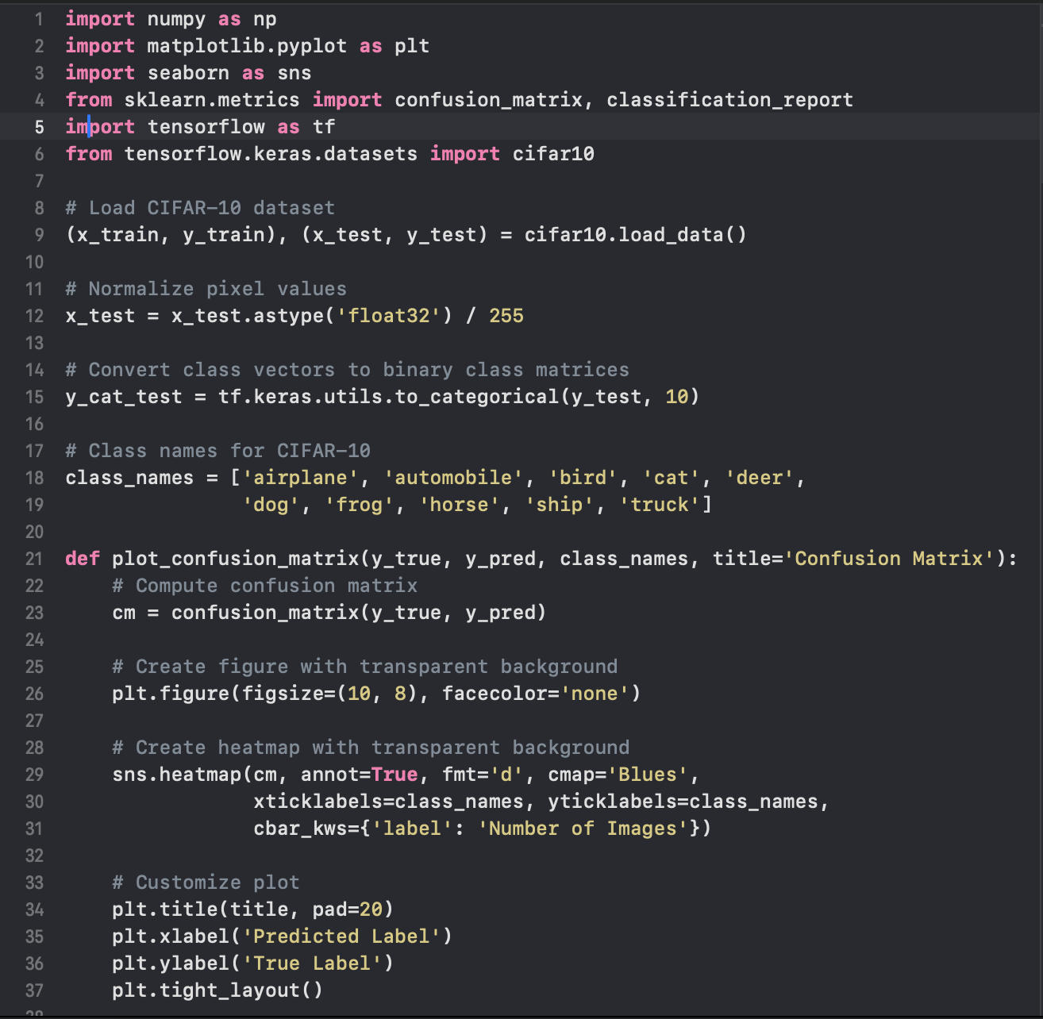
Introduction to Machine Learning
University of Essex
Appendix

Slide 15
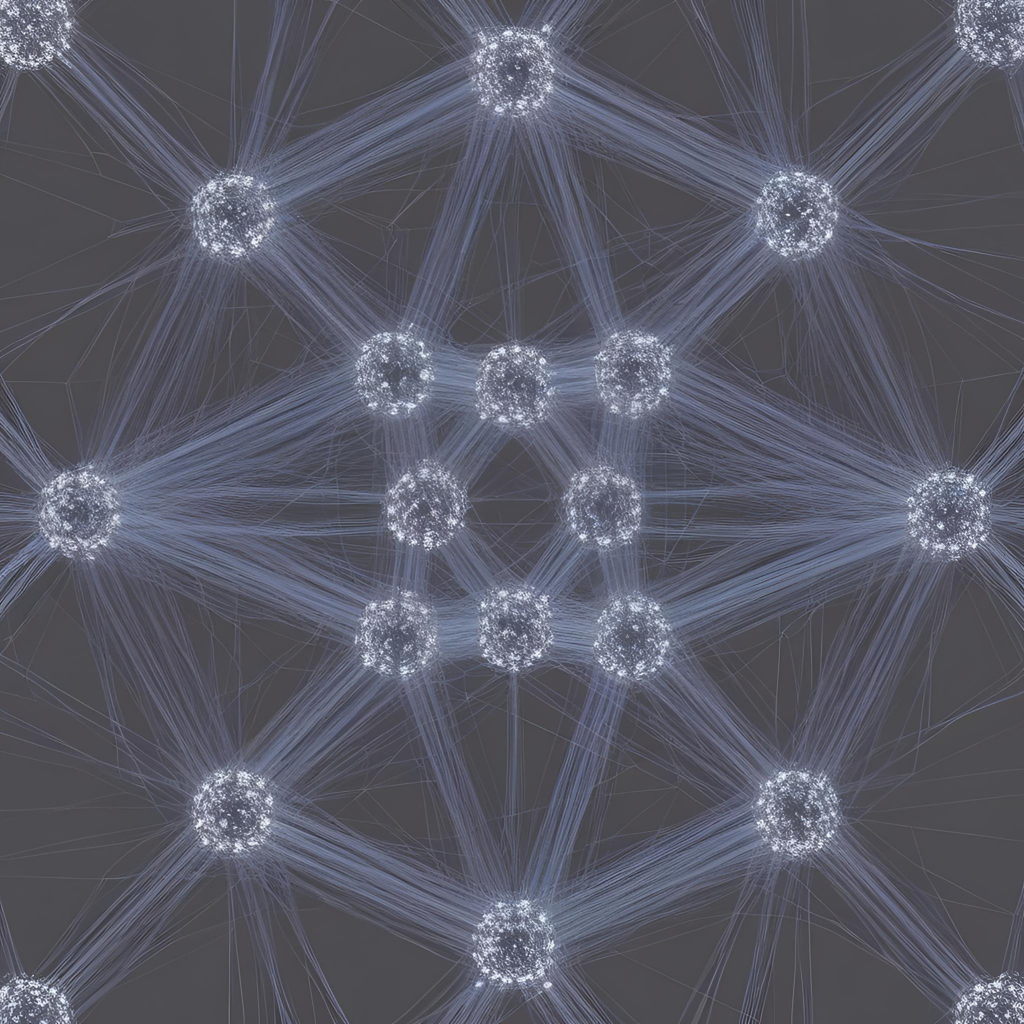
Introduction to Machine Learning
University of Essex
Thank you

